Slide 1



BigDataProject
View in Power BI
Last data refresh:
8/13/2023 5:09:41 AM UTC
Downloaded at:
8/13/2023 5:12:02 AM UTC

Slide 2
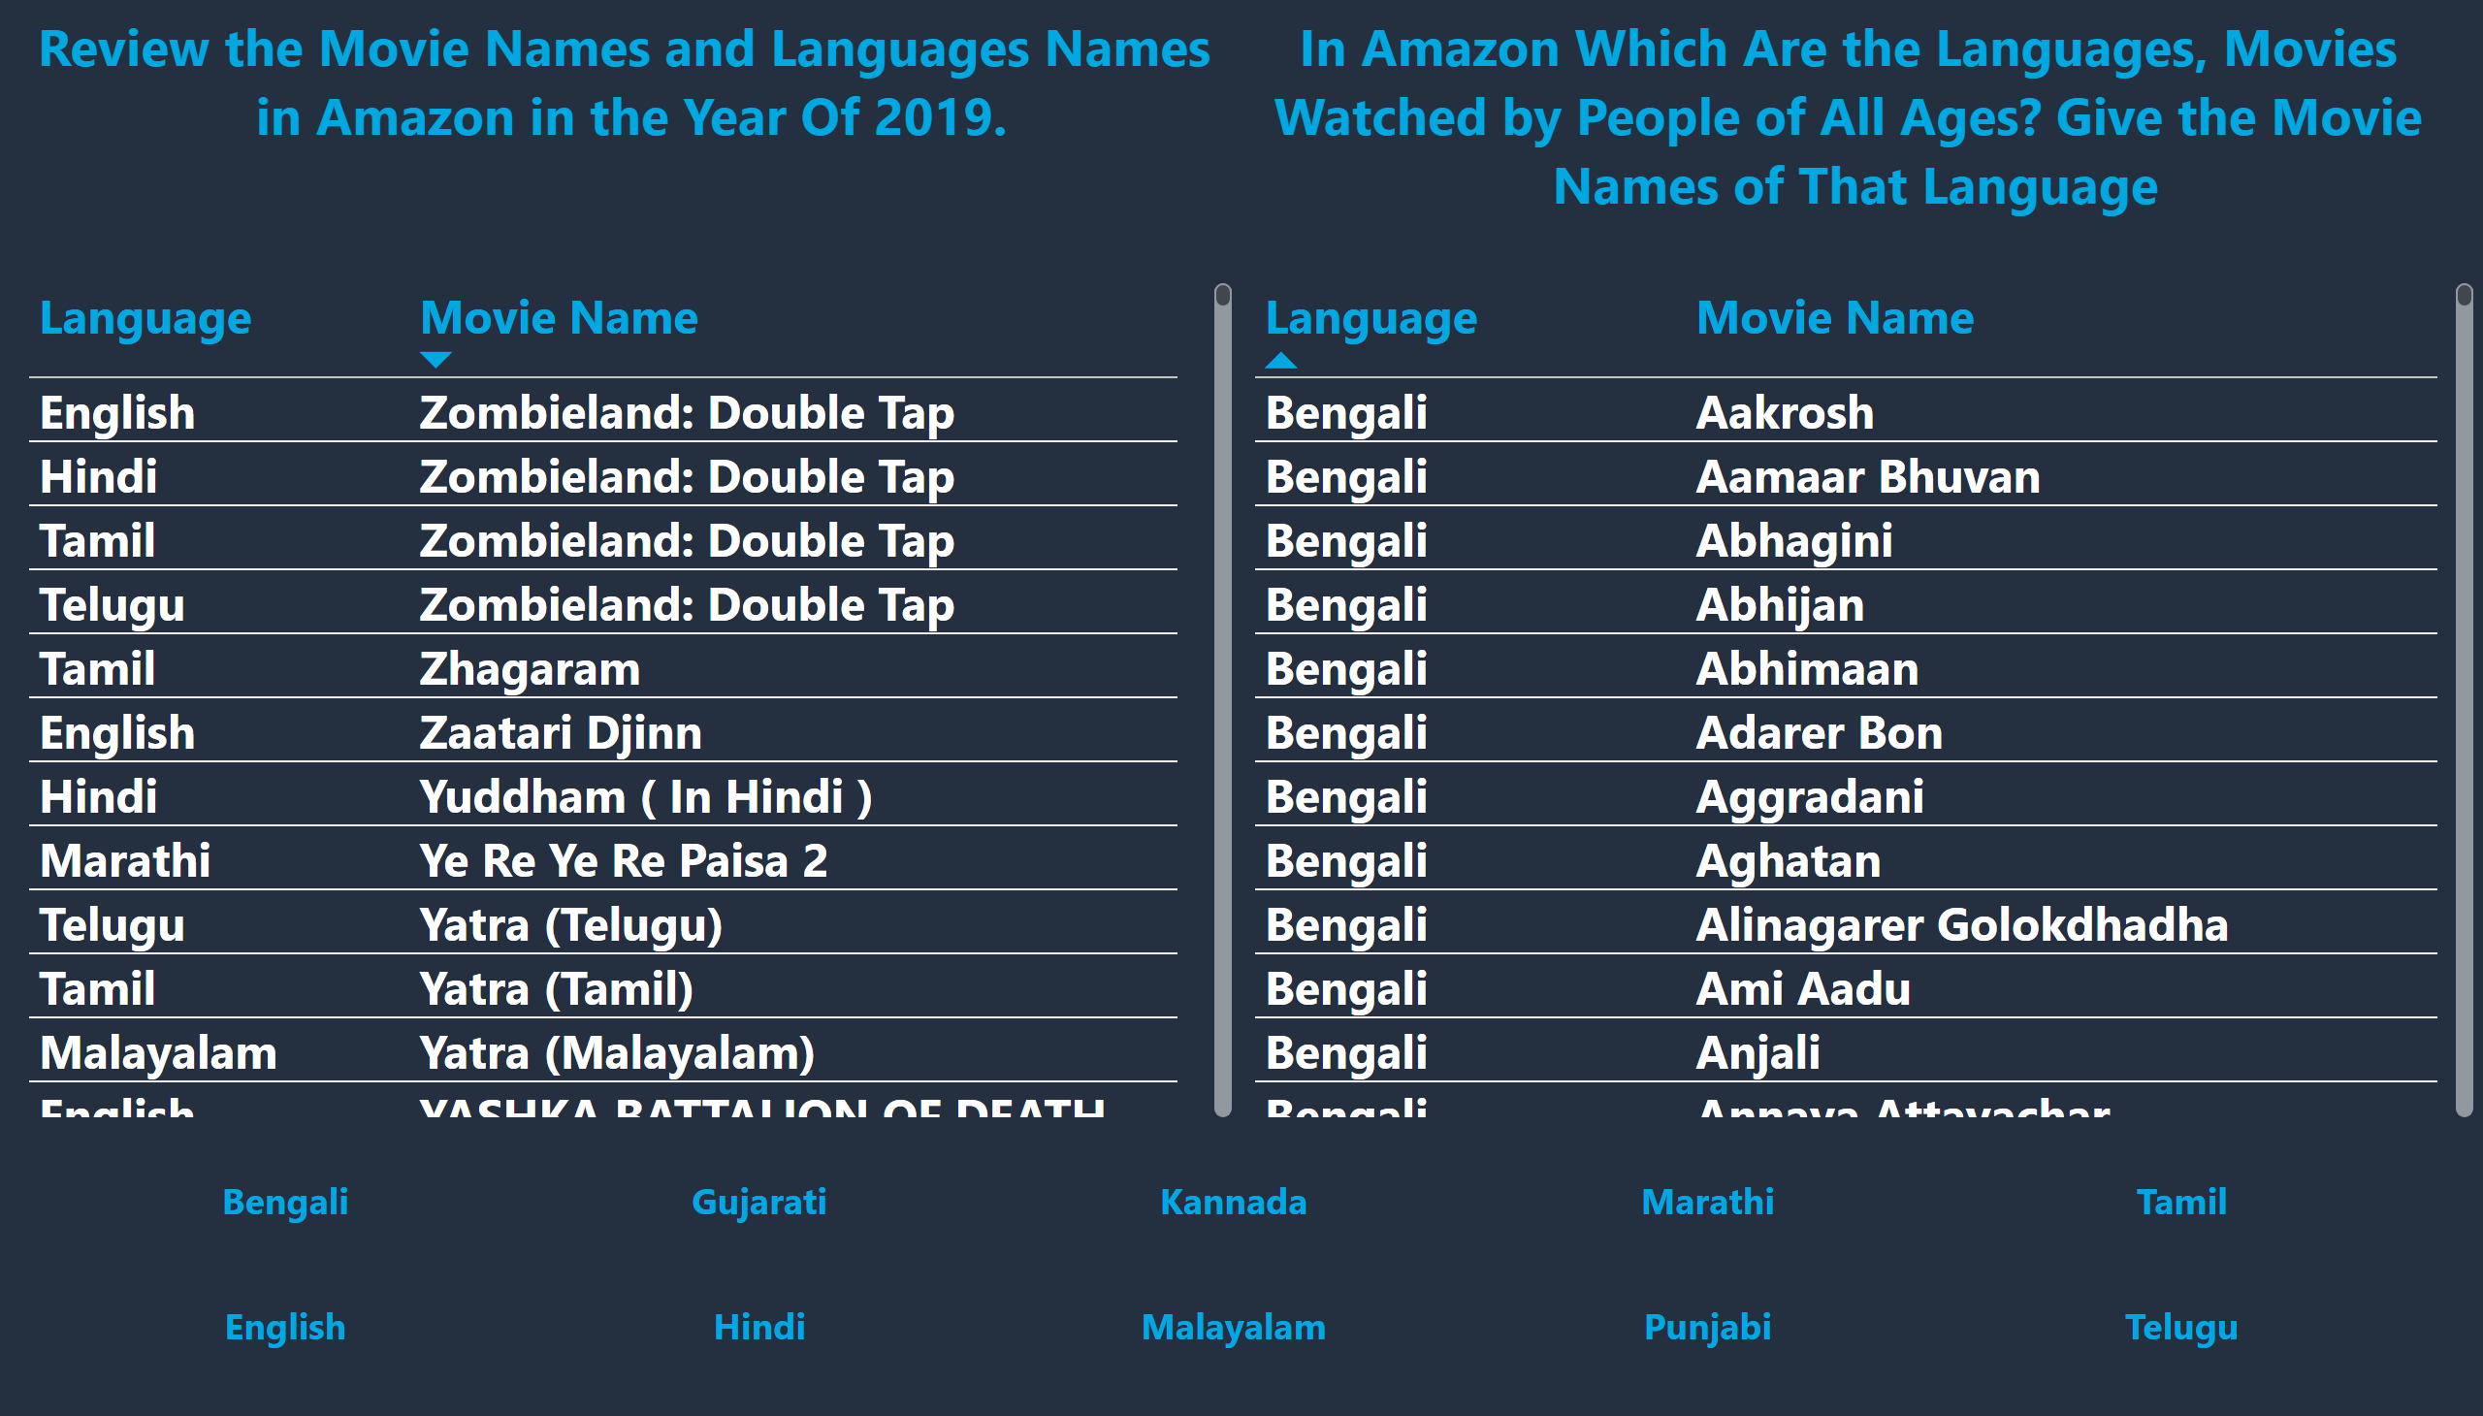
Amazon 1, 2
Notes:
textbox
No alt text provided
tableEx
No alt text provided
slicer
No alt text provided
textbox
No alt text provided
tableEx
No alt text provided

Slide 3
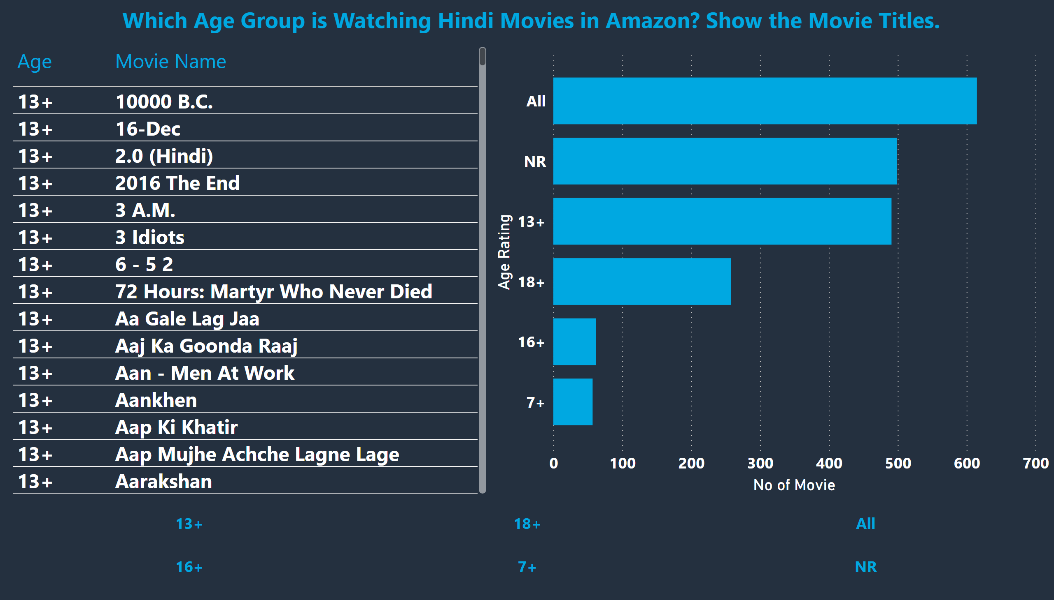
Amazon 3
Notes:
textbox
No alt text provided
tableEx
No alt text provided
slicer
No alt text provided
barChart
No alt text provided

Slide 4
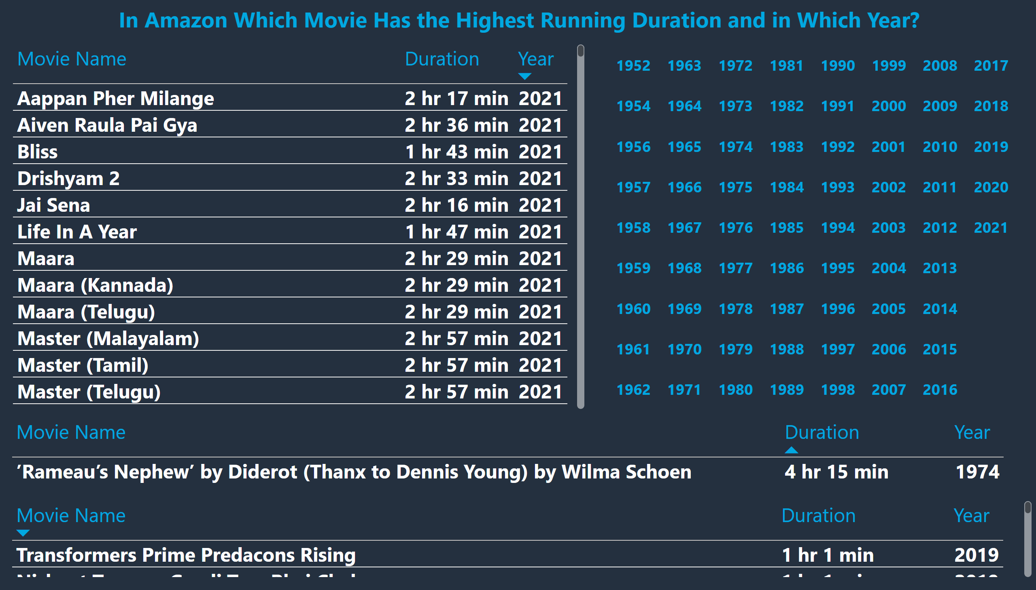
Amazon 4
Notes:
textbox
No alt text provided
tableEx
No alt text provided
slicer
No alt text provided
tableEx
No alt text provided
tableEx
No alt text provided

Slide 5
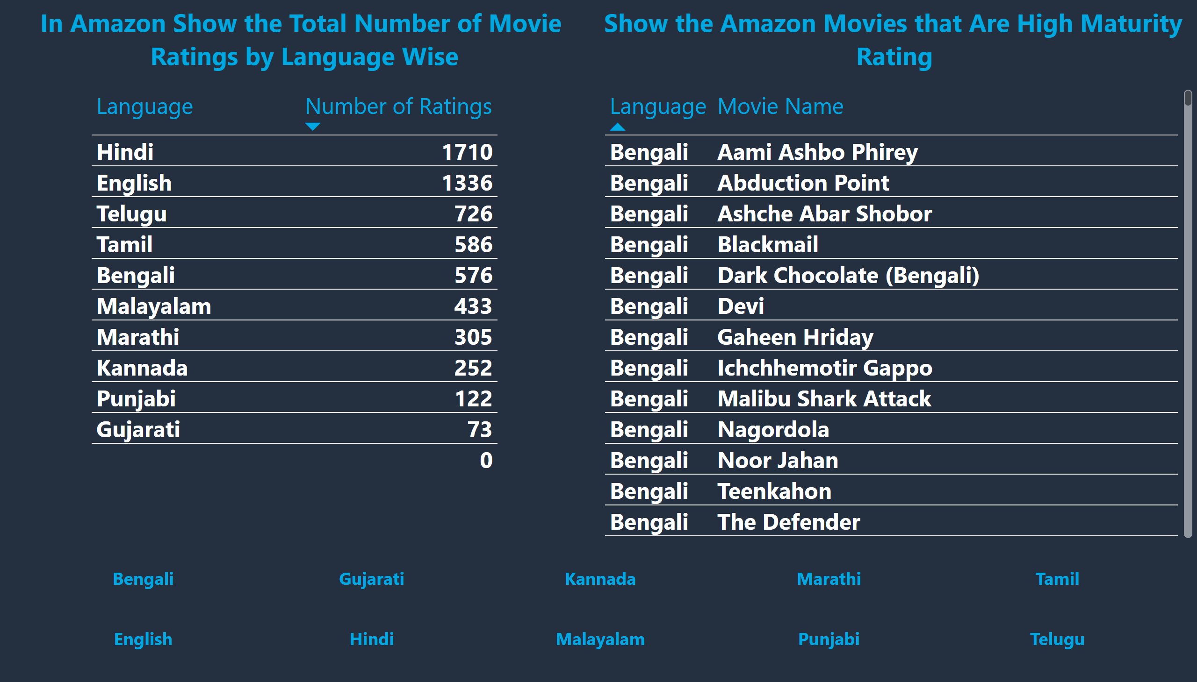
Amazon 5, 6
Notes:
textbox
No alt text provided
tableEx
No alt text provided
tableEx
No alt text provided
textbox
No alt text provided
slicer
No alt text provided

Slide 6
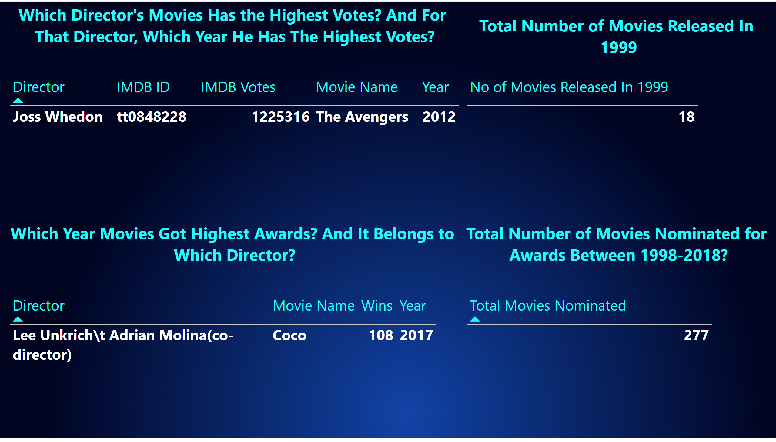
Disney 1, 2, 3, 4
Notes:
textbox
No alt text provided
tableEx
No alt text provided
textbox
No alt text provided
textbox
No alt text provided
textbox
No alt text provided
tableEx
No alt text provided
tableEx
No alt text provided
tableEx
No alt text provided

Slide 7
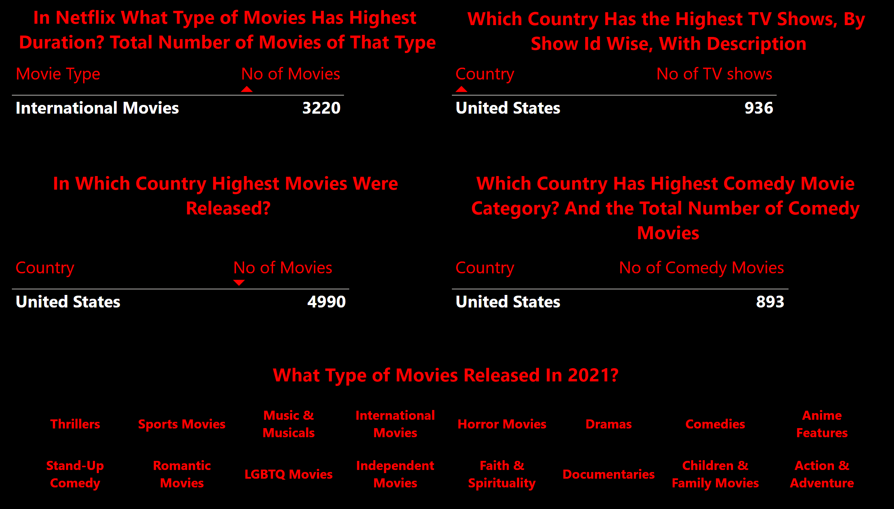
Netflix 1, 2, 3, 4, 5
Notes:
textbox
No alt text provided
tableEx
No alt text provided
textbox
No alt text provided
tableEx
No alt text provided
textbox
No alt text provided
textbox
No alt text provided
tableEx
No alt text provided
tableEx
No alt text provided
slicer
No alt text provided
textbox
No alt text provided

Slide 8
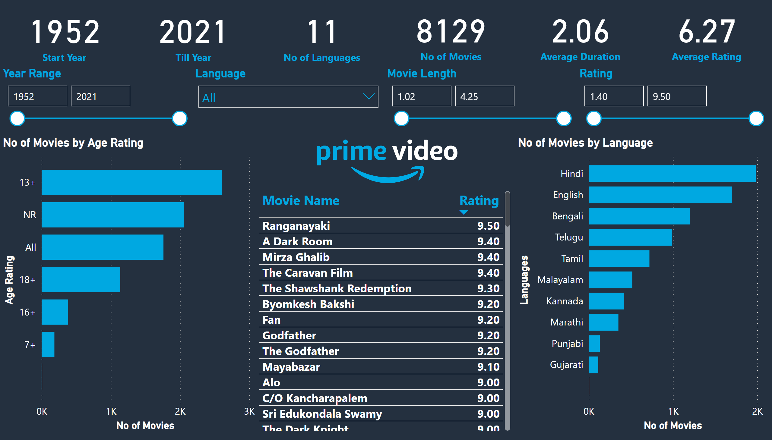
Amazon
Notes:
card
No alt text provided
card
No alt text provided
card
No alt text provided
card
No alt text provided
card
No alt text provided
card
No alt text provided
Year Range
No alt text provided
Language
No alt text provided
Movie Length
No alt text provided
Rating
No alt text provided
No of Movies by Language
No alt text provided
No of Movies by Age Rating
No alt text provided
image
No alt text provided
tableEx
No alt text provided

Slide 9
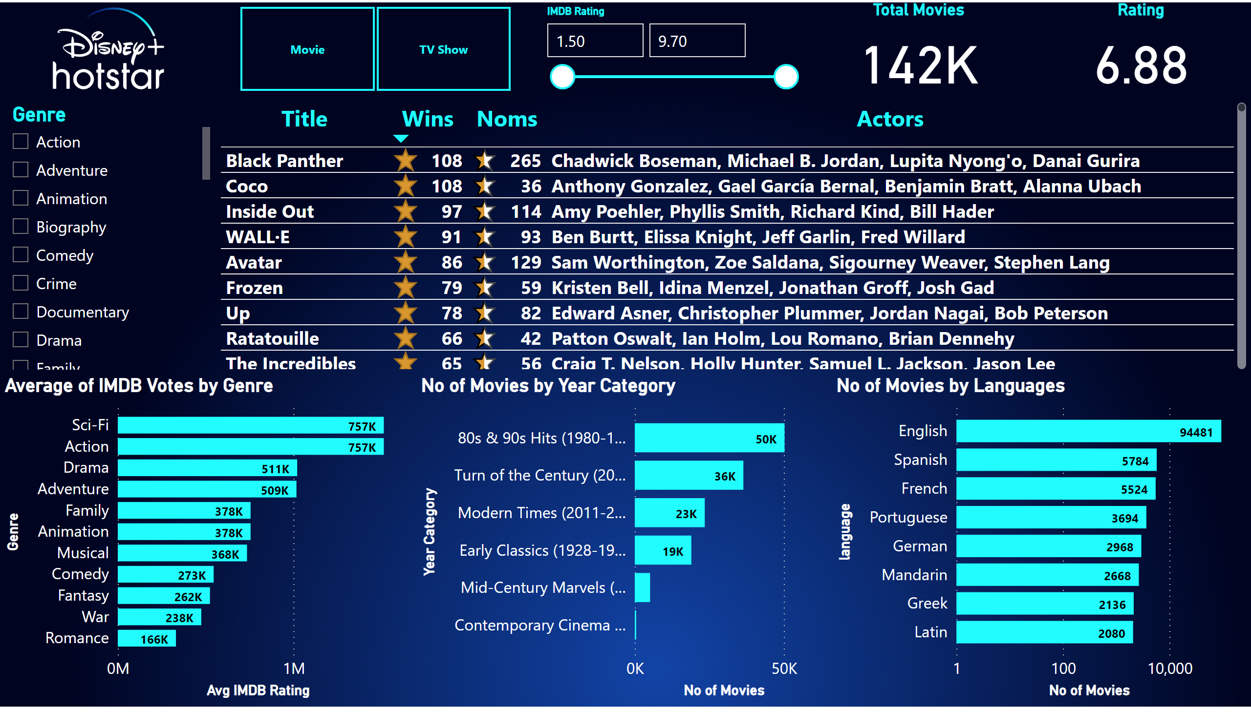
Disney
Notes:
slicer
No alt text provided
slicer
No alt text provided
efefe
No alt text provided
Average of IMDB Votes by Genre
No alt text provided
No of Movies by Year Category
No alt text provided
Total Movies
No alt text provided
Rating
No alt text provided
tableEx
No alt text provided
No of Movies by Languages
No alt text provided
image
No alt text provided

Slide 10
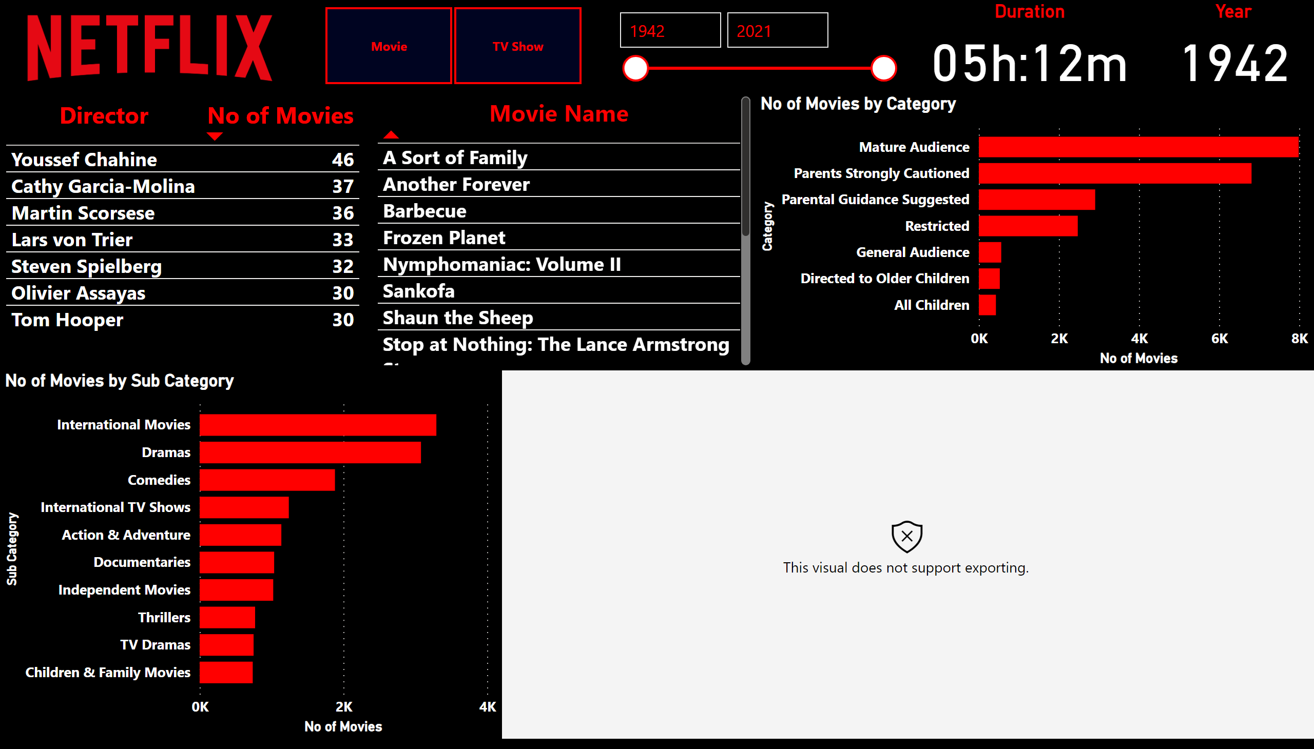
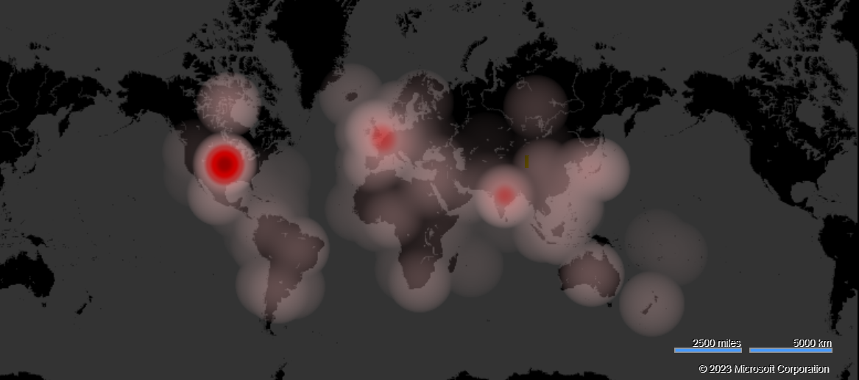
Netflix
Notes:
No of Movies by Category
No alt text provided
No of Movies by Sub Category
No alt text provided
tableEx
No alt text provided
slicer
No alt text provided
slicer
No alt text provided
Duration
No alt text provided
image
No alt text provided
tableEx
No alt text provided
Year
No alt text provided
heatmapF244EA9EE1F34E828A80CF19B41976F8
No alt text provided

